Slide 1
Predicting smog levels With meteorological inputs Using A Neural Network
Darsh Patel

Slide 2
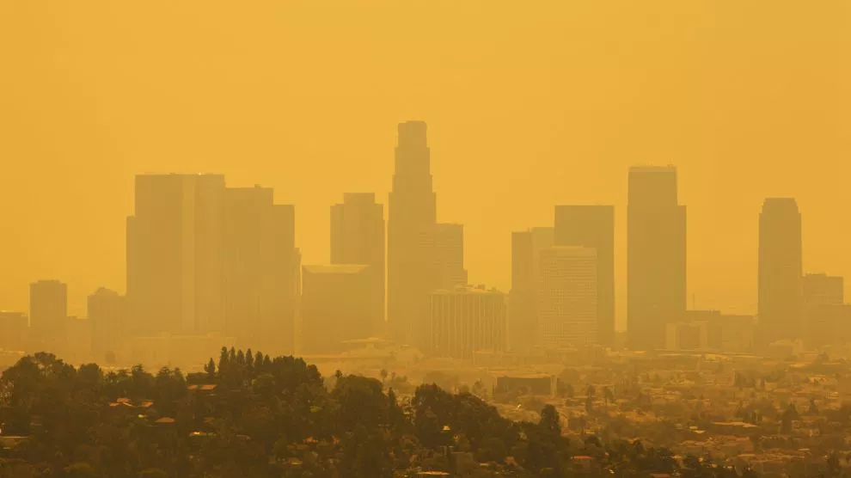
The Problem
Air pollution leads to several lung problems – asthma, wheezing, bronchitis
Can be measured by O3, NO2, NO, PM2.5, and PM10
Prediction can provide scientific understanding of mechanisms of dispersion as well as emission control strategies

Slide 3
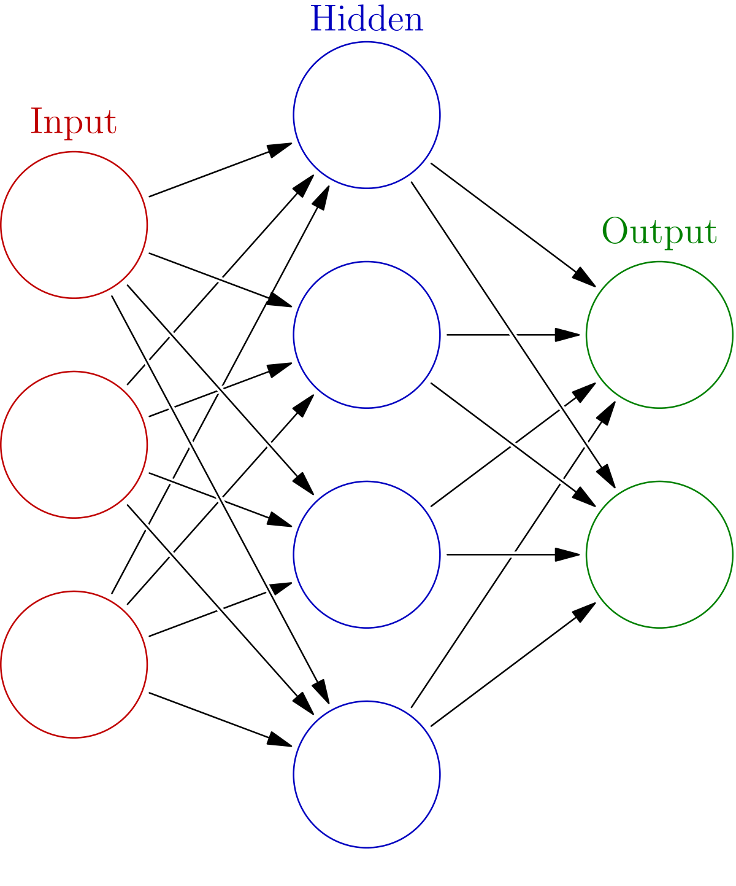
Background
Neural network modeled after human brain
Consists of input layer, hidden layers, and output layer, each with distinct weights and biases
Multi-layer perceptron uses backpropagation -> compares system output with expected output (error) and adjusts weights and biases
Binary classification neural network – outputs a value from 0-1 (used in conj. w/WHO guidelines)
Support vector machine – classification

Slide 4
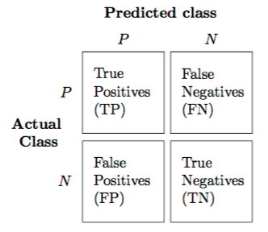
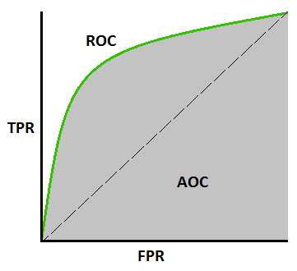
Evaluation Metrics
Confusion matrix – displays false positives, false negatives, true positives, true negatives in table format
ROC Curve – compares rate of true positive rate vs. false positive rate for different thresholds
RMSE, R2, index of agreement

Slide 5
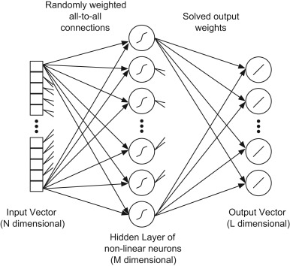
Previous Research
Study in New Zealand – measured NO2 concentrations with 8 predictor variables: ws, wd, sr, temp, rh, hr, day, month (Elangasignhe, 2014)
  Found neural network to be lowest RMSE
  Study in Hong Kong – predicted NO2, NO, O3, and PM2.5 with variables such as hi temp, lo temp, ws, wd, rh, and time variables (Zhang & Ding, 2017)
  Used ELM (extreme learning machine)

Slide 6
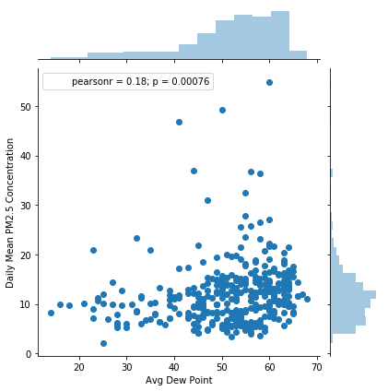

Inputs
Temperature
Cloud Cover (average)
Wind speed
Relative humidity
Atmospheric pressure
Precipitation
2017 data

Slide 7
Data Format
Season | Week | Avg. PM 2.5 (µg/m³) | Avg. Temp (F) | Avg. Wind Speed (mph) | Cloud Cover (%) | Atmospheric Pressure (mb) | Precipitation (in)
Winter ‘17 | Week 1
 | Week 2
 | Week 3
 | Week 4
 | Week 5
 | Week 6
 | Week 7
 | Week 8
 | Week 9
 | …

Slide 8
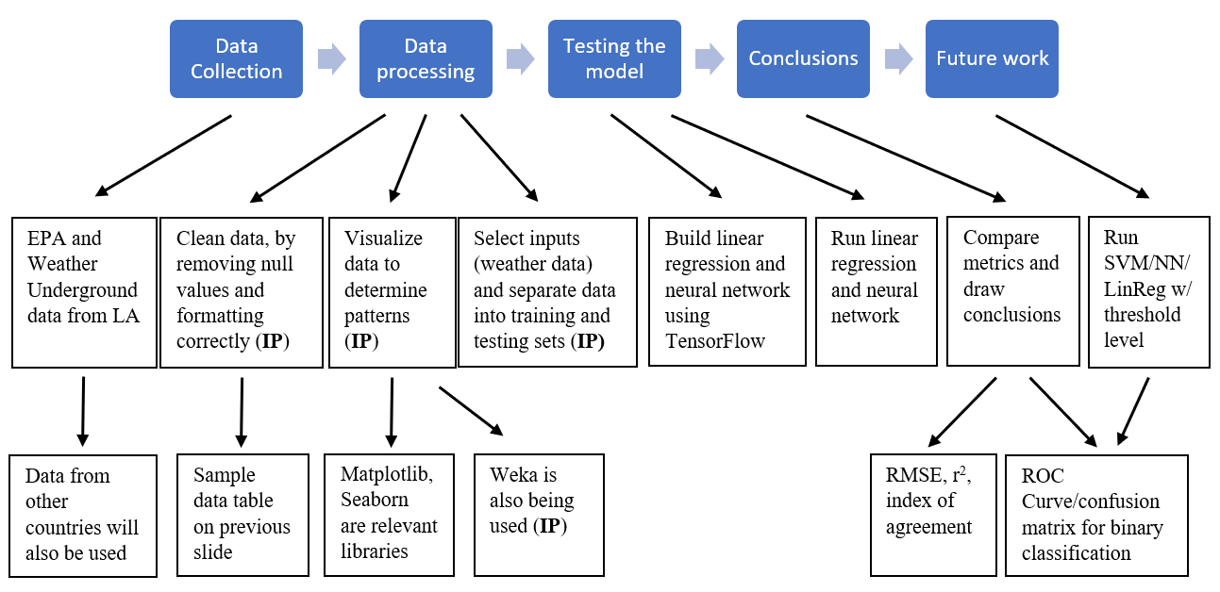
Experimental Design

Slide 9
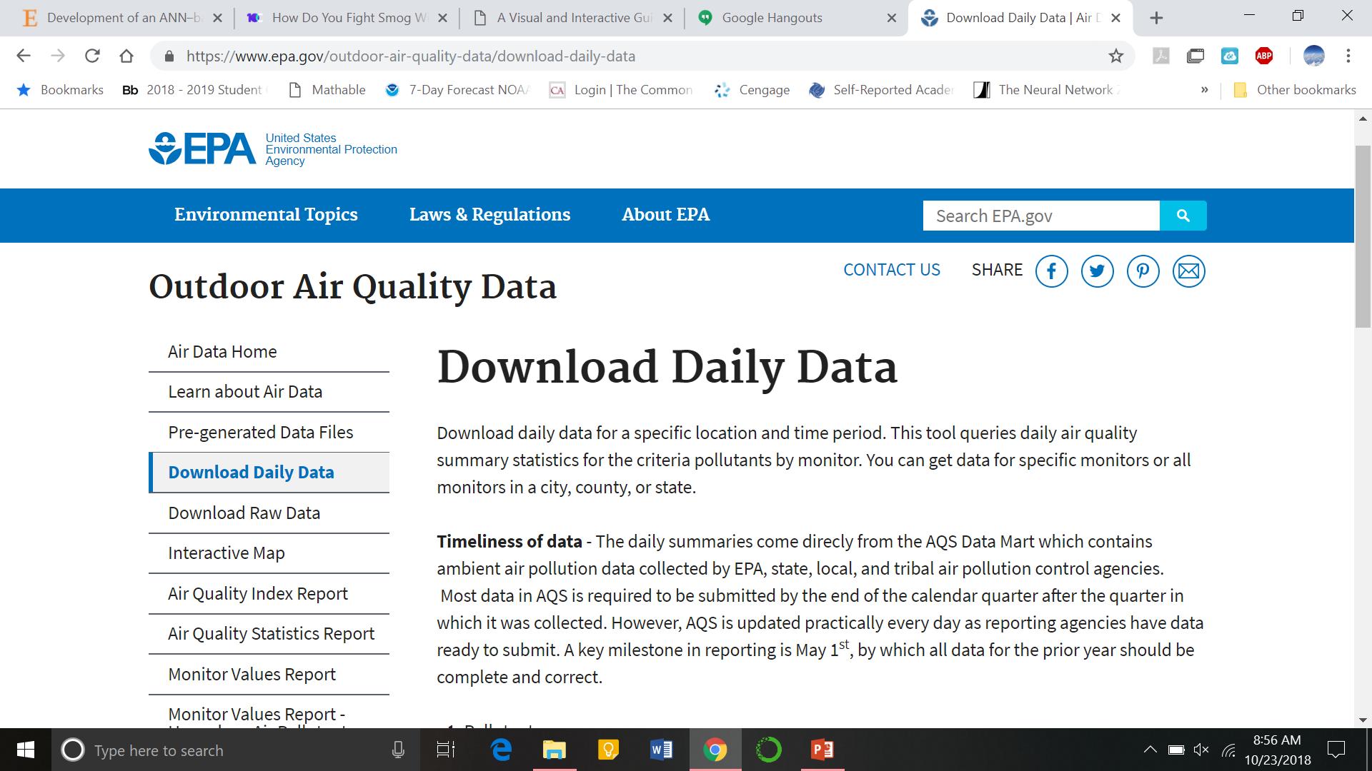
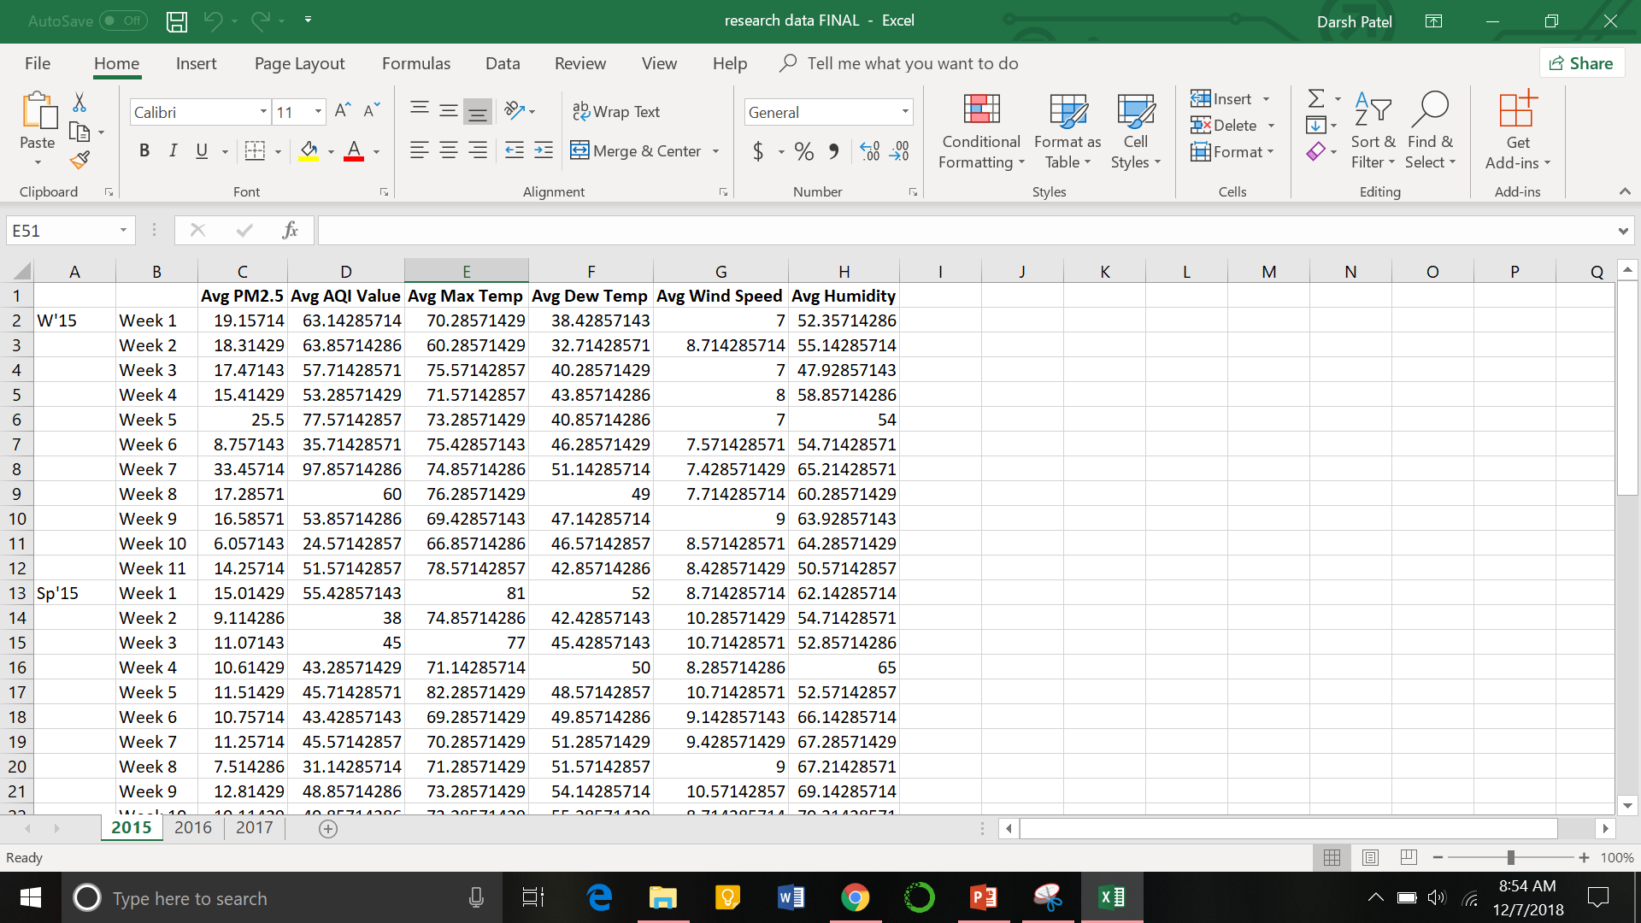
Progress
Data source found – EPA, Weather Underground
Currently formatting data
Downloaded Weka, started playing around with it
Emailed authors of research in NZ, Chicago, and HK

Slide 10
References
Zhang, J. & Ding, W. (2017). Prediction of Air Pollutants Concentration Based on an Extreme Learning Machine: The Case of Hong Kong. International Journal of Environmental Research and Public Health. https://doi.org/10.3390/ijerph14020114
Deters, J. K., Zalakeviciute, R., Gonzales, M., & Rybarczyk, Y. (2017) Modeling PM2.5 Urban Pollution Using Machine Learning and Selected Meteorological Parameters. Journal of Electrical and Computer Engineering. https://doi.org/10.1155/2017/5106045
Elangasinghe, M. A., Singhal, N., Dirks, K. N., & Salmond, J. A. (2017) Development of an ANN–based air pollution forecasting system with explicit knowledge through sensitivity analysis. Atmospheric Pollution Research. https://doi.org/10.5094/APR.2014.079

